Slide 1
TASK 3 Scanning Report on Finding Vulnerabilities of a Website
Using OWASP Scanner

Slide 2
Domain: http://testfire.net
Risk Levels of the Vulnerability:
Three Risk levels were found which Include High, Medium, Low and Informational type
Confidence Levels of the Vulnerability:
Four levels include User Confirmed, High, Medium, Low

Slide 3
Steps To Reproduce
STEP 1: OPEN VIRTUAL BOX AND LOGIN TO LINUX
STEP 2: OPEN A VIRTUAL BANK WEBSITE , for example ., www.testfire.net
STEP 3: OPEN OWASP ZAP APP FOR VULNERABILITY FINDING
STEP 4: OPEN OWASP ZAP THEN GIVE THE DETAILS OF THE WEBSITE EITHER THE URL OR IP ADDRESS
STEP 5: THEN START ATTACKING
STEP 6: U CAN SEE THE PROCESS , AFTER THE COMPLETION CLICK ON REPORT THEN SAVE IT AS .html FILE NOW THE REQUIRED REPORT IS SAVED
STEP 7 : IN THE REPORT ,ALL THE REQUIRED WILL BE OBTAINED like., vulnerabilities ,url’s and the solution.

Slide 4
Vulnerabilities Alert Found
Cross Site Scripting (Reflected) - High Risk
X-Frame Options Header Not Set- Medium
Absence Of Anti-CSRF Tokens- Low
Cookie Without Same Site Attribute- Low
Cross- Domain JavaScript Source File Inclusion- Low
Timestamp Disclosure- Unix – Low
X- Content Type Options Header Missing- Low
Information Disclosure- Informational

Slide 5
Vulnerabilities Details
Cross Site Scripting(Reflected):
It is a High Risk Vulnerability found on the Method : POST http://testfire.net/sendFeedback
Impact:
The attacker can hijack user accounts.
An attacker could steal credentials.
An attacker could exfiltrate sensitive data.
An attacker can steal cookies and Sessions.
An attacker can quickly obtain access to your other client’s computers.
Prevention:
XSS is a code injection vulnerability, so it is essential to encode the data sent to the server and the data that comes from the server to the browser of a user.
Data Validation is also very important so that the browser interprets the code without any malicious commands. Different prevention methods were introduced, keeping the data Validation and Encoding as a priority for a website to be vulnerable to XSS.

Slide 6
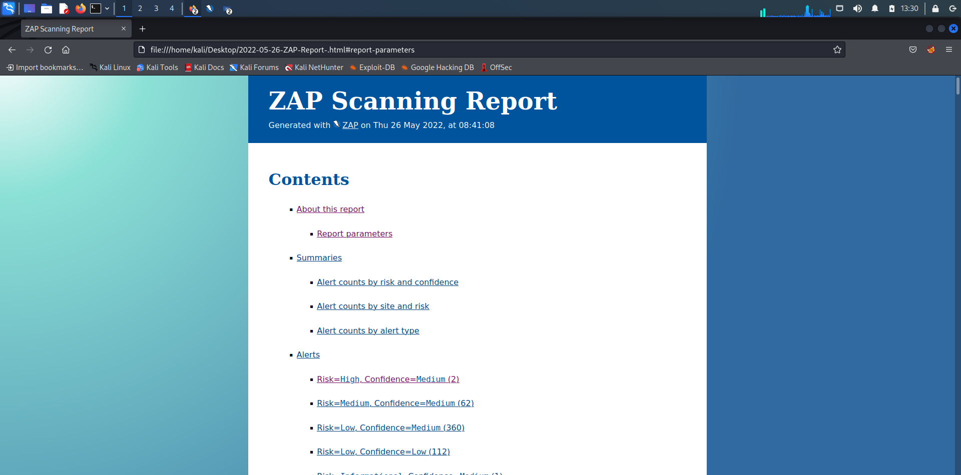
Proof Of the Concept

Slide 7
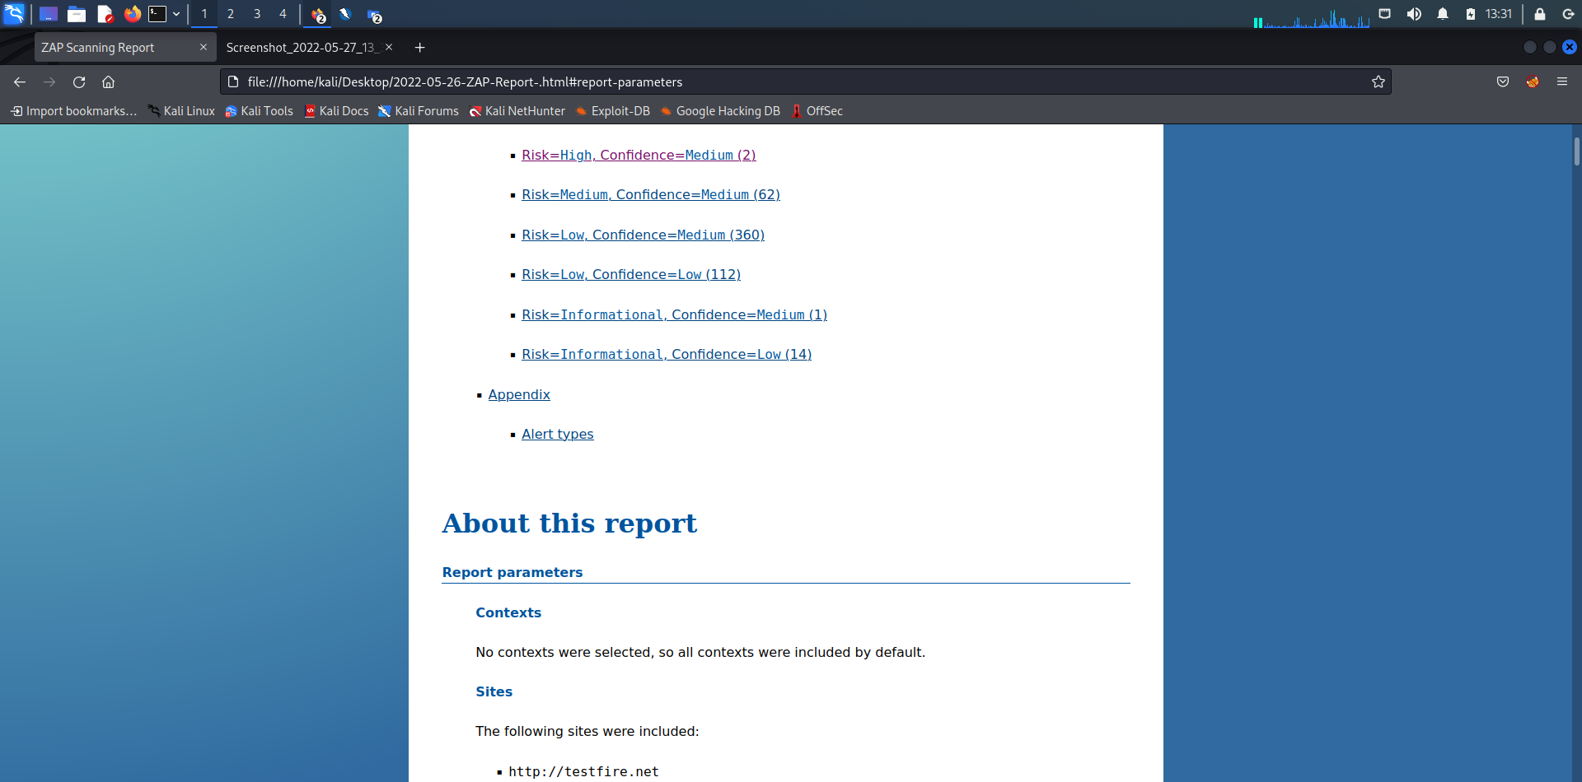

Slide 8
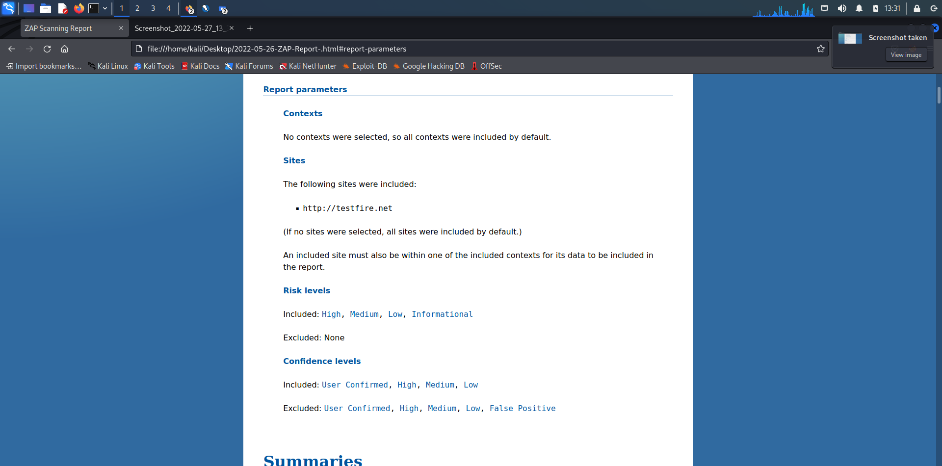

Slide 9
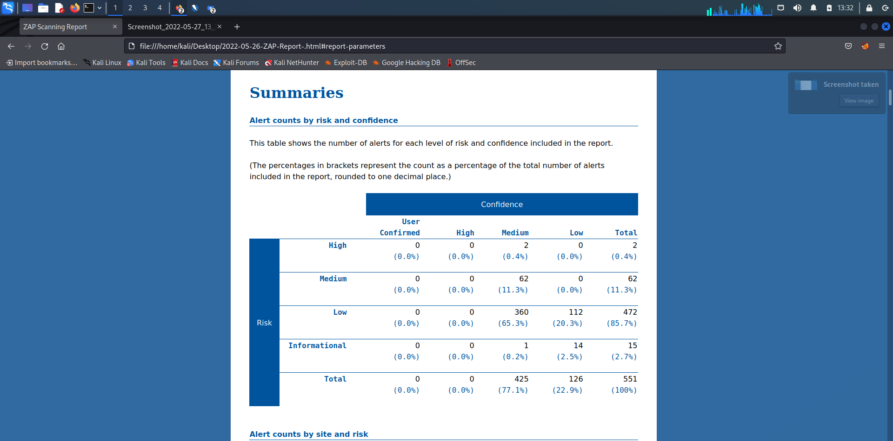

Slide 10
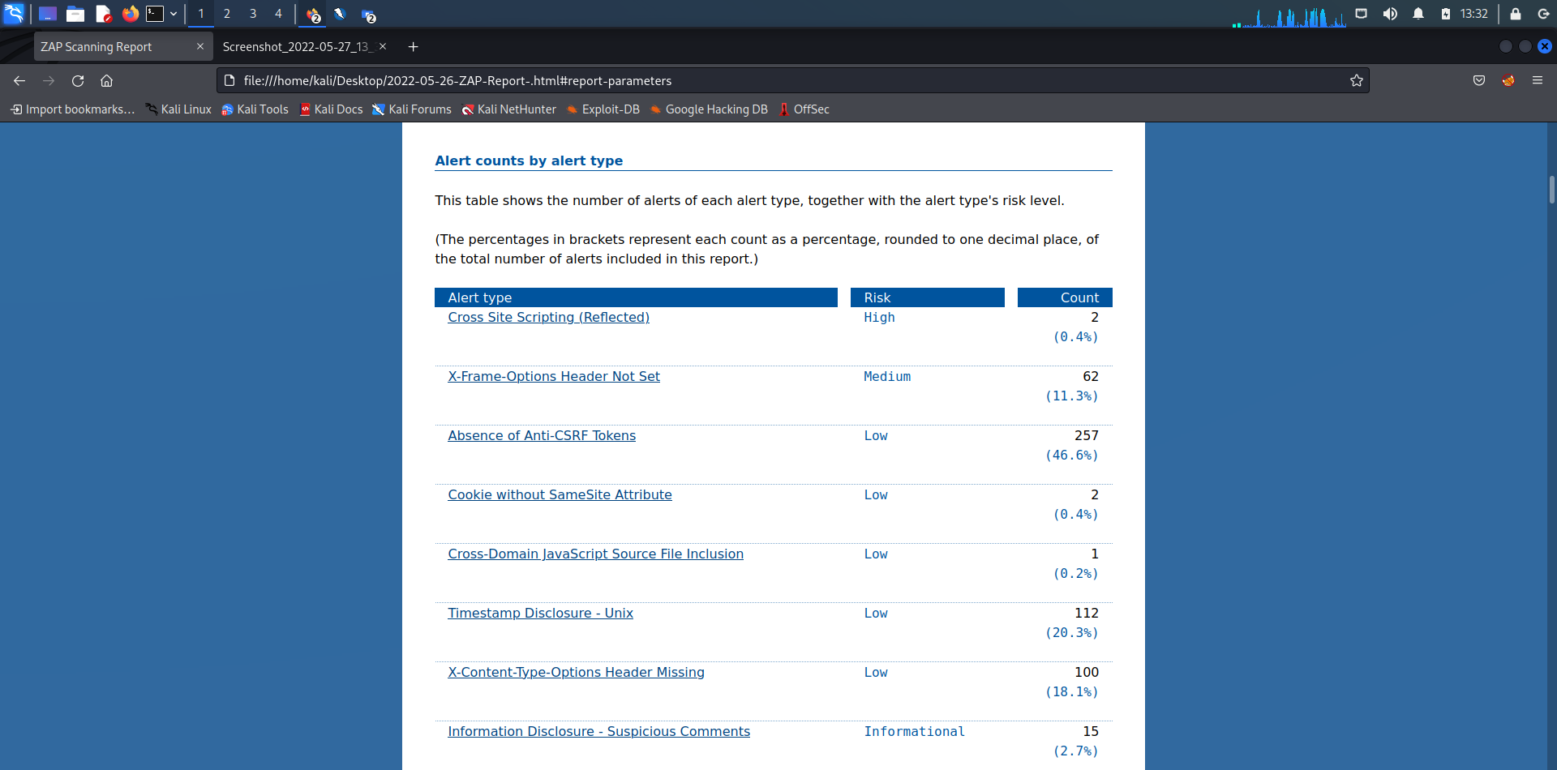

Slide 11
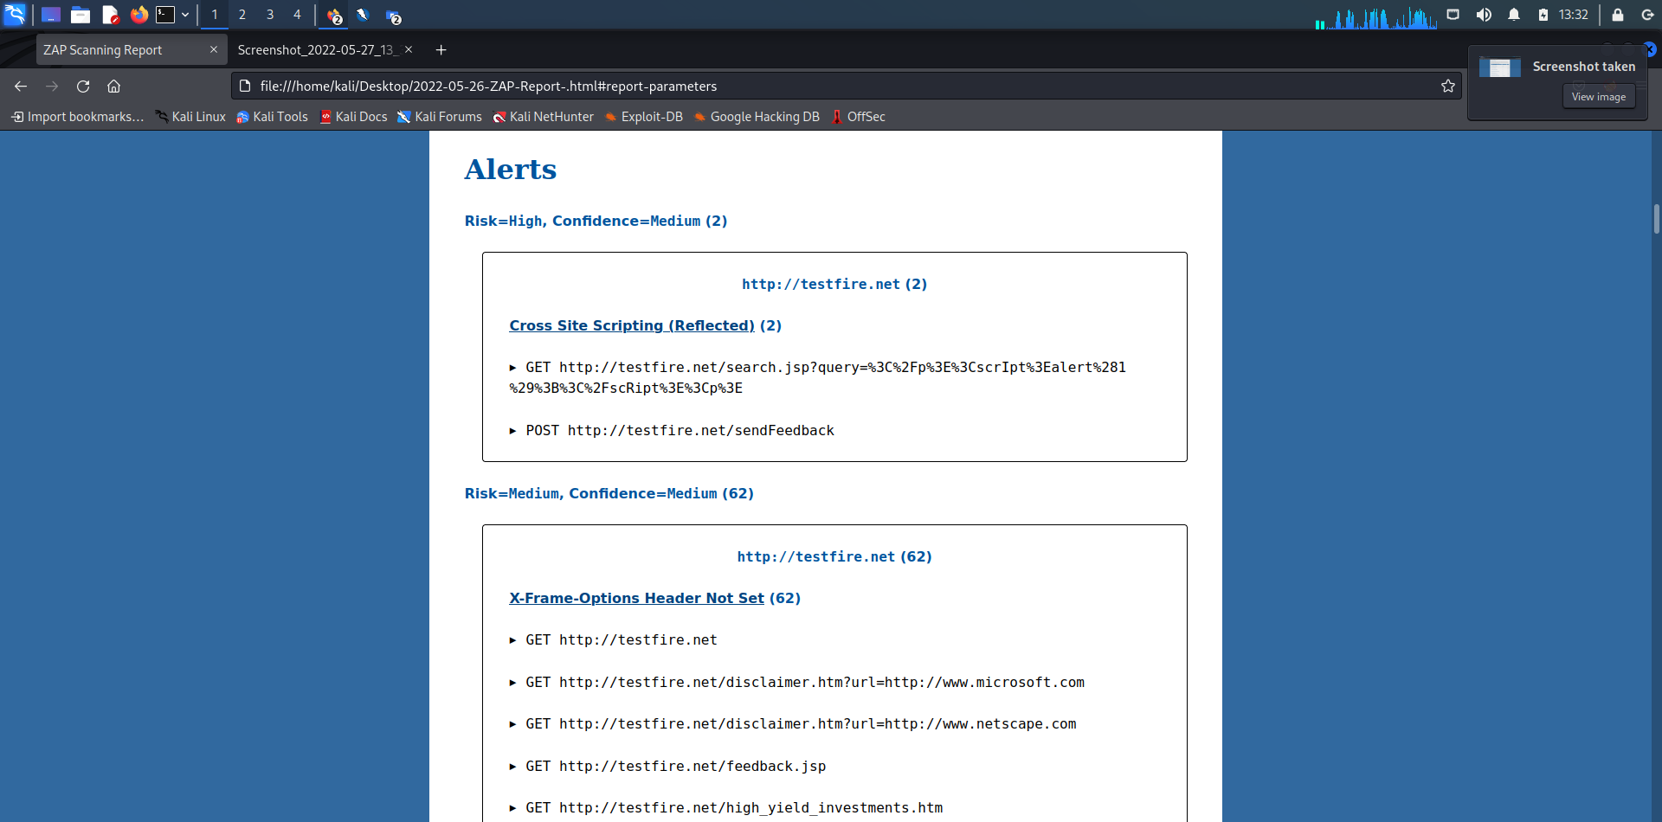

Slide 12
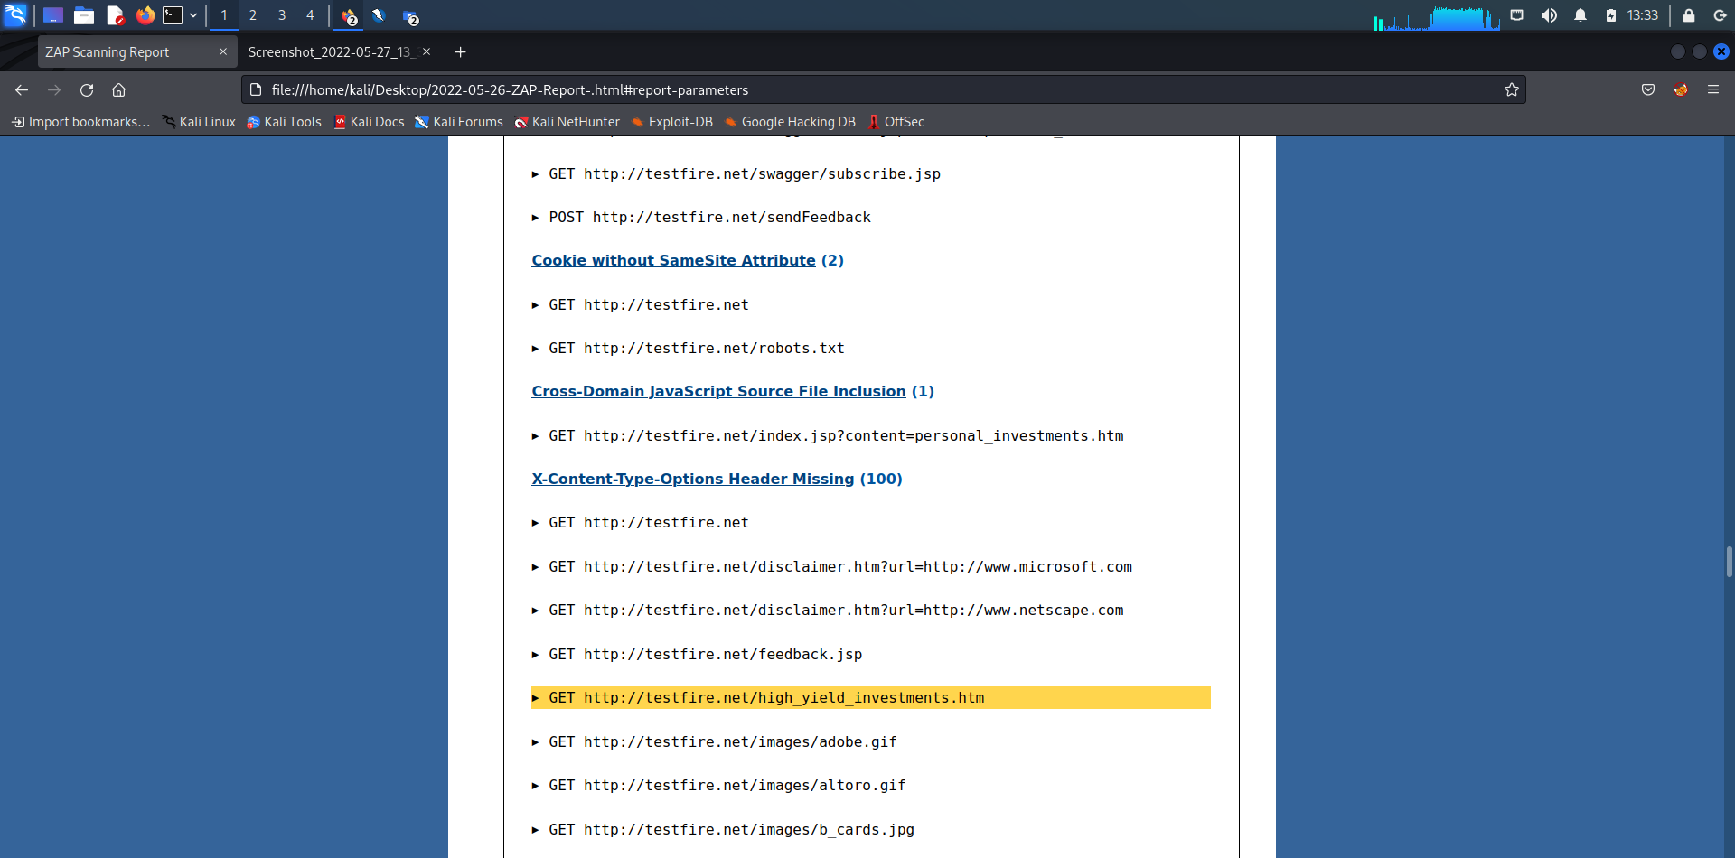

Slide 13
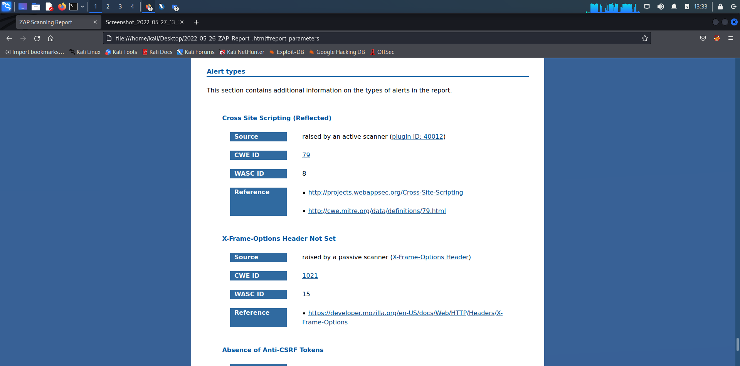

Slide 14
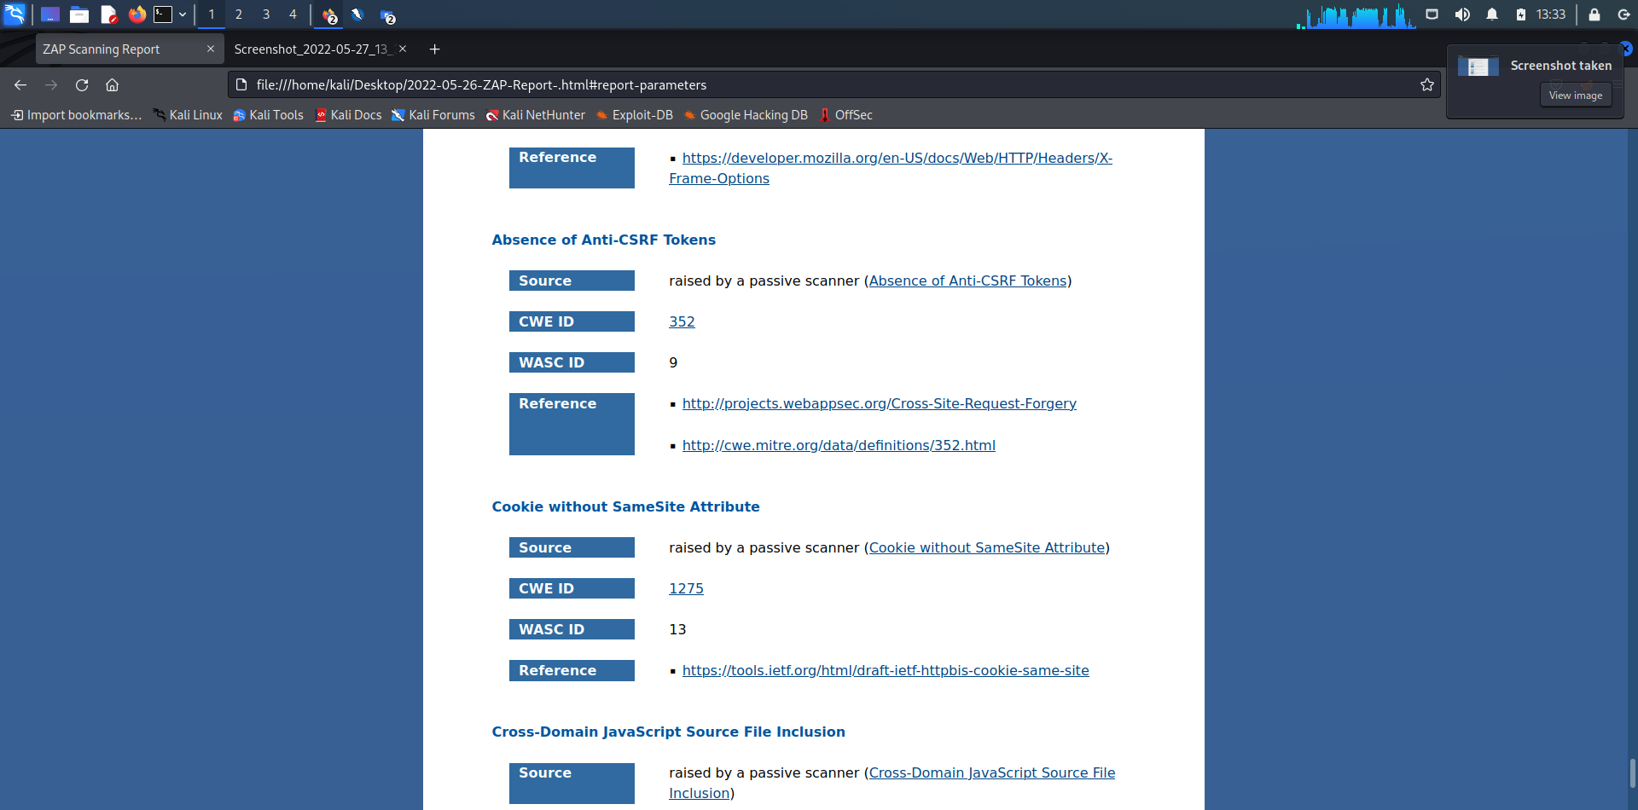

Slide 15
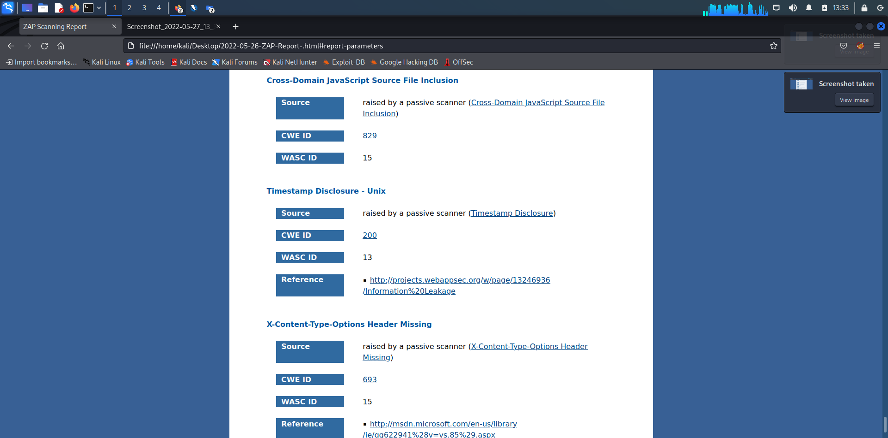

Slide 16
Conclusion
Vulnerabilities found should be removed by mitigation techniques for the safety of the Users critical Information.

